Slide 1
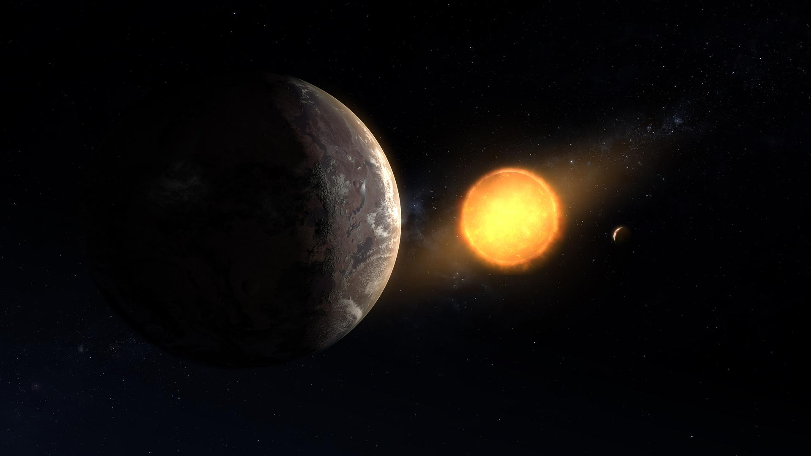
2025 NASA Space App Challenge
Team Nebulatic – ExoTic Vision
Yusuf Emre Boyraz
Yusuf Baki Demiryürek
Hamza Tekin
Kerim Çatalbaş
Challenge
A World Away: Hunting for Exoplanets with AI
GitHub
Credit:https://science.nasa.gov/gallery/exoplanets/

Slide 2
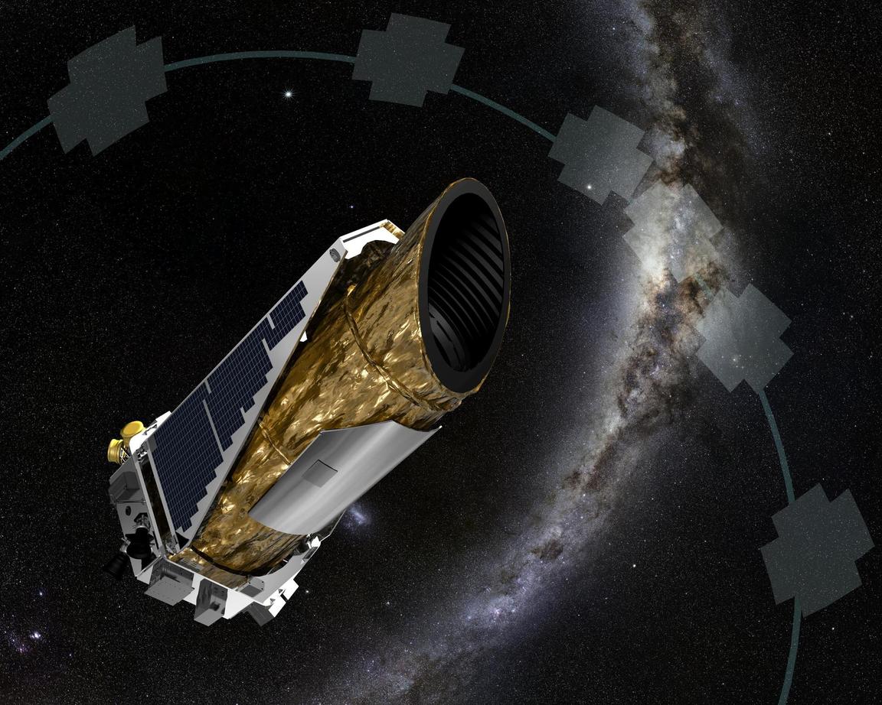
Collecting Data and Methodology
Findings
Data Collection
Kepler Objects of Interest (KOI)
Eight mutual parameters within datasets
TESS Objects of Interest (TOI)
Best output with using 6 mutual parameters;
K2 Planets and Candidates
(Orbital Period, Transit Duration, Planet Radius,
Stellar Temperature, Stellar Radius, Transit Depth)
total 21,271 records
Articles
Methods
Exoplanet detection using machine learning
(1)
Stacking Ensemble Algorithm
Assessment of Ensemble-Based Machine Learning Algorithms for Exoplanet Identification
Binary classification with 6 parameters
Credit:https://science.nasa.gov/mission/kepler
(2)
(1) Monthly Notices of the Royal Astronomical Society, Volume 513, Issue 4, July 2022, Pages 5505–5516,
https://doi.org/10.1093/mnras/stab3692
(2) Electronics 2024, 13(19), 3950; https://doi.org/10.3390/electronics13193950

Slide 3
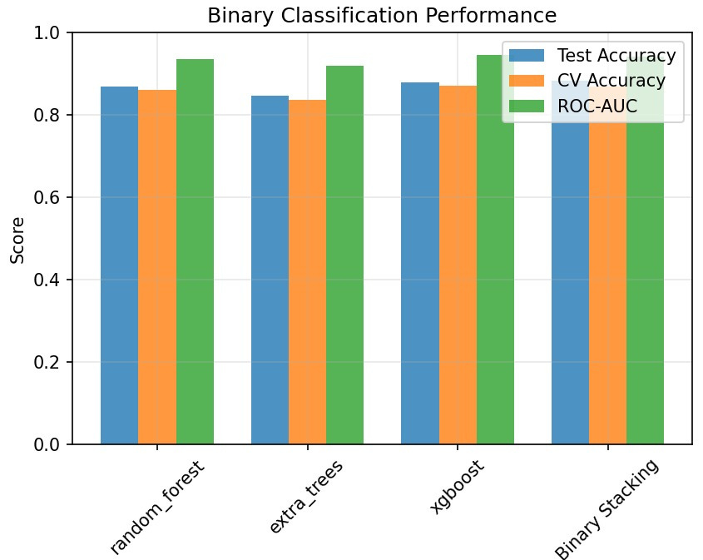
Model Selection and Statistics
Random Forest
Stacking
Ensemble
random_forest : 86.8% accuracy (ROC-AUC: 0.9362)
extra_trees : 84.7% accuracy (ROC-AUC: 0.9191)
xgboost : 87.8% accuracy (ROC-AUC: 0.9454)
Binary Stacking : 88.2% accuracy (ROC-AUC: 0.9411)
Extra Trees
XGBoost

Slide 4
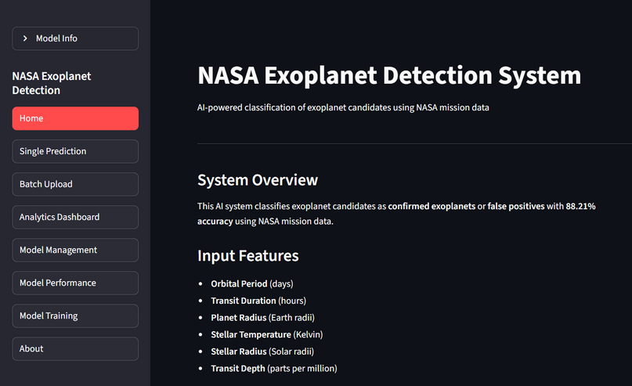
WebApp and Practical Use
nebulatic.streamlit.app
Features
Tech Stack
Single Prediction
Streamlit as Web Framework
Batch Upload
Python as programming language
Model Training
ML Libraries:
Model Management
(Scikit-Learn, XGBoost, imbalanced-learn, pandas, numpy, matplotlib...)
“Launching with a Website MVP”

Slide 5
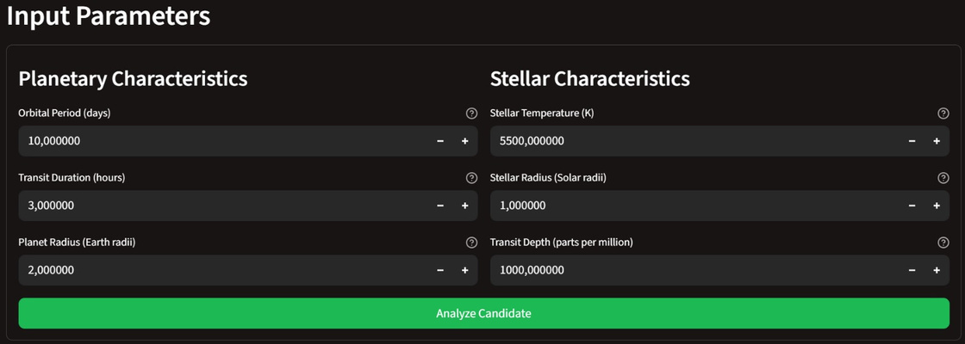
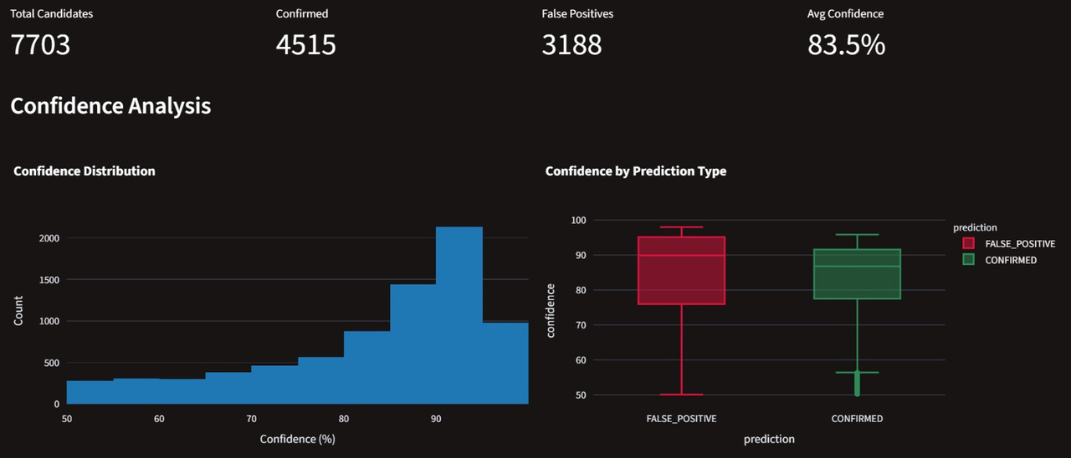
Prediction Techniuqes
6 Parameters → Unit Validation
Single Prediction
CONFIRMED / FALSE_POSITIVE
Confidence score
Quick Single-Candidate check
CSV template
Batch Prediction
Auto column mapping
Summary distribution (CONFIRMED/FP)
Graphical confidence analysis
Download results as CSV

Slide 6
Model Training and Management
Model training:
Upload new
training data
Manual-Auto column mapping
Combine with NASA dataset
(optional)
Name your model
Download/Save model
Start the training
Hypermeter tweaking
(optional)
Choose training algirithm
Model management:
Saved models can be reused later within the app or removed.

Slide 7
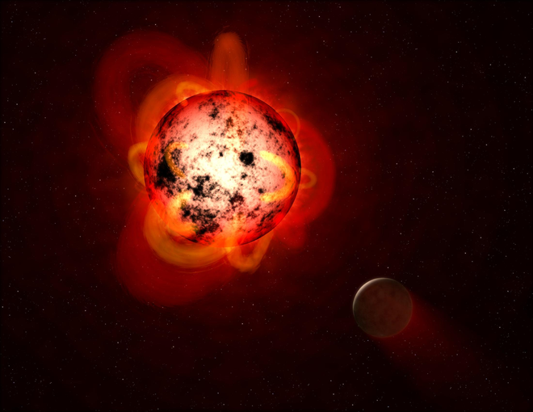

Conclusion and Future Implementations
Conclusion
Combined Kepler+K2+TESS
Robust preprocessing, engineered features
XGBoost/CatBoost > baselines
Stable across splits/missions
Fewer false positives; faster review
Future Work
More personalized experience
Error dashboard
Active learning loop
More advanced models(public models)
MLOps: versioning, monitoring, drift, auto retrain
Credit: https://science.nasa.gov/image-detail/amf-pia21473/
Photo by Tara Winstead on Pexels
THANK YOU

